Slide 1
Mzuzu Entrepreneur Hub
Operations

Slide 2
About Mzuzu E-hub
Entrepreneurship and innovation hub in Mzuzu, Malawi
FOUNDED
2017 in Mzuzu, Malawi
NO. EMPLOYEES
11 employees
EXPERIENCE
3 years experience in running business incubation programs and entrepreneurship trainings in Malawi.
FOCUS
Ideation to seed stage startups, Early stage enterprises, social enterprise, leadership, sector agnostic
ENTREPRENEURSHIP SUPPORT PROGRAMMES
Bizcubation
Entrepreneurship Education and Outreach
COVID19 Youth incubation program
Mzuzu Pitch Night
#PitchDay
STARTUPS & BUSINESSES SERVED
104+ startups, 15,000 youths and women.

Slide 3
Legal structure
Registered as a company limited by guarantee (not for profit)

Slide 4
Our services/ programs
Media information and literacy Education program
Entrepreneurship Education and Outreach program
Bizcubation Program
Working space

Slide 5
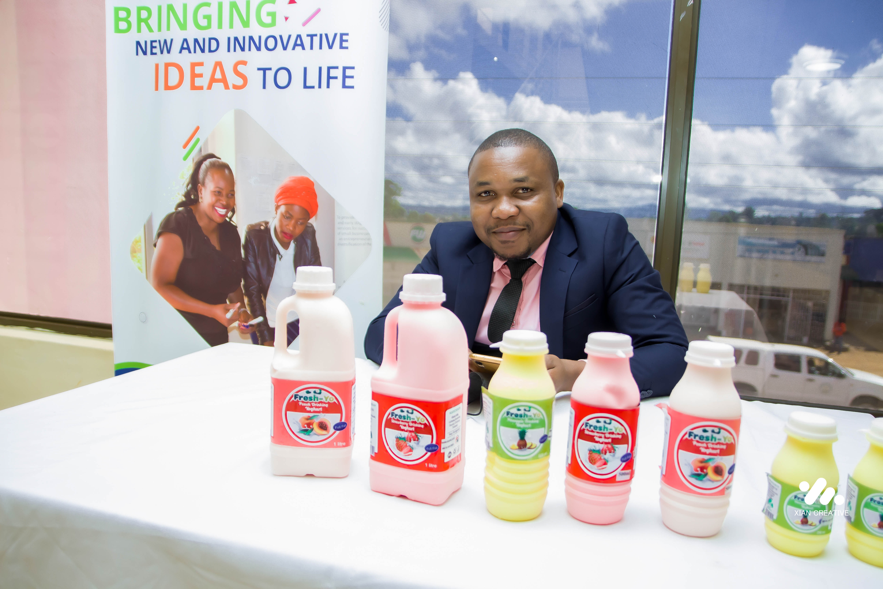
Entrepreneur Specific Support
Mentorship and coaching
Co-working space
Capacity building trainings
Investment opportunities
Networking opportunities
Information and knowledge transfer
Marketing and visibility

Slide 6
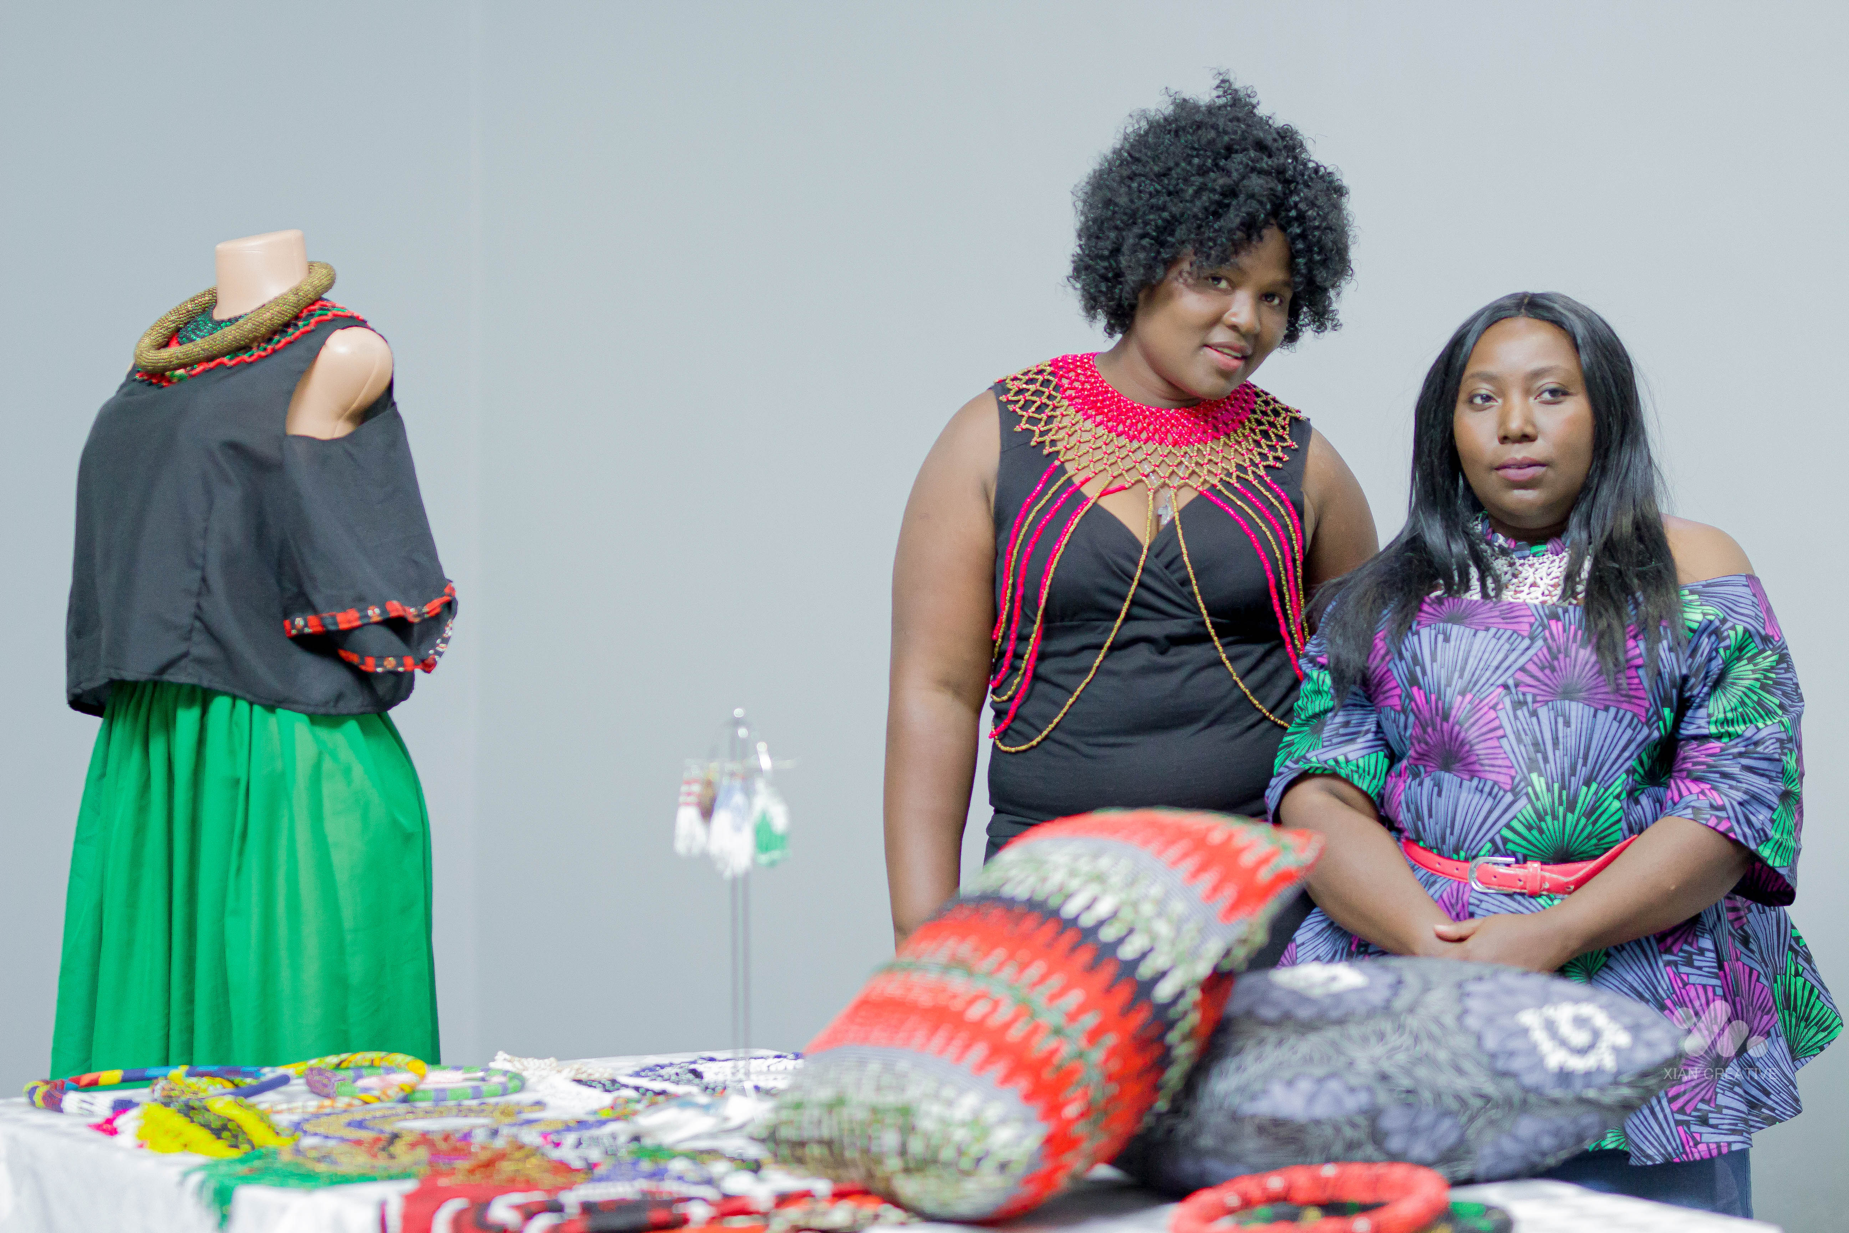
High growth sectors
Agriculture (production, processing and distribution)
Clean Energy (Solar, Biogas, hydro power)
ICT
Fashion and design

Slide 7
TARGET
Start-ups
Early stage
Idea stage
Students
8 – 35 years old

Slide 8
Ecosystem Building
We leverage partnerships for growth

