Slide 1


Becoming an independently verified Fair Trade Enterprise
Martin Rhodes
Ross Isdale

Slide 2

What is Fair Trade?
"Fair Trade is a trading partnership, based on dialogue, transparency and respect, that seeks greater equity in international trade.
It contributes to sustainable development by offering better trading conditions to, and securing the rights of, marginalized producers and workers – especially in the South.”
Notes:
It’s an alternative way of doing business that aims to build an equal and respectful relationship between producers in developing countries and consumers. Producers give consumers a product they need, and consumers in return give them a fair price; this creates a mutually beneficial relationship.
Fair Trade exists within the much broader trade justice movement which is also concerned with many issues such reducing the monopoly of large companies, ensuring income tax is paid etc. Worth bearing in mind that FT is one response to the problem of trade injustice: it deals with giving producers from developing countries the opportunity to sell their products for a fairer price and on fairer trading terms.

Slide 3
How does Fair Trade contribute to trade and development?
Outcome | Practices
Economic : Better prices, better incomes for producers | Minimum and fair prices
Environmental sustainability | Sustainable farming and production practices required.
Social : Decent working conditions & workers’ rights | Adherence to the policies of the International Labour Organization, especially those concerning child and forced labour and the right to collective bargaining
All practices externally monitored, audited, and verified by independent third parties.
Notes:
Coffee farmers in Costa Rica have used the premium to replant trees to prevent soil erosion and have invested in environmentally friendly ovens
Fairtrade Premiums are often used to train producers in organic and sustainable techniques like composting and using recycled materials, which can help them to convert to organic production in the future

Slide 4



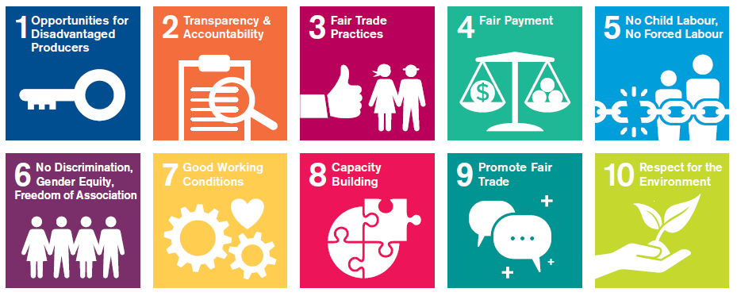

Slide 5

Questions?

Slide 6

Becoming a Guaranteed Member of the WFTO
Internationally recognised and acclaimed verification system
Join a community of over 1,000 social enterprises and 1,500 shops spread across 83 countries
Rigorously assessed based on organisational structure and business model, its operations and its supply chains.
Notes:
The WFTO is the global community and verifier of social enterprises that fully practice Fair Trade. Spread across 83 countries, WFTO members all exist to serve marginalised communities. To be a WFTO Guaranteed member, an enterprise or organisation must demonstrate they put people and planet first in everything they do. They are democratically run by their members, who are part of a broader community of over 1,000 social enterprises and 1,500 shops. To become Guaranteed and to maintain this status, members need to be assessed through the WFTO Guarantee System (GS) which we will come on to in a moment.
Some introductory statistics about those already members of the WFTO
Profits for purpose
92 per cent reinvest all
profits in their social mission
Led by women
52 per cent of CEOs are
women
More resilient
4 times less likely to go
bankrupt
Can put people and planet over profit
85 per cent report actively sacrificing financial goals to pursue social or environmental goals, while retaining commercial viability

Slide 7













WFTO = Fair Trade + Social Enterprise
Commodity / product certification
Enterprise
+ supply chain
Enterprise verification
Notes:
A raft of commodity certifications have arisen to focus on individual ingredients or commodities within products. Meanwhile, the last decade has seen a growth of verification systems to assess the mission and purpose of the broader business. The WFTO model is a hybrid of the two ideas.
The WFTO GS combines Fair Trade and social enterprise verification into one. It is built to verify that an enterprise is mission-led, focused on the interests of its producers, and this is in the structure, systems and practices of the enterprise. It was created by experts and pioneers from the Fair Trade movement so as to be credible, clear, and affordable. In contrast to commodity certifiers, the GS assesses the entirety of a business, not just a specific product, ingredient or supply chain. It includes an assessment of the enterprise’s structure and business model, its operations and its supply chains. Members that pass the GS process attain the ‘Guaranteed Fair Trade Enterprise’ status and may use the WFTO Label on their products.

Slide 8

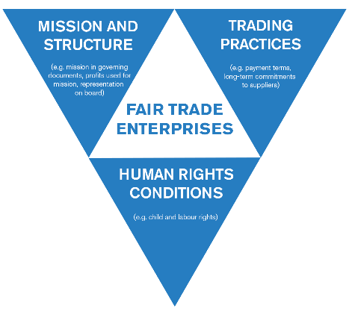
WFTO Guarantee System
  PROCESS
  Initial application
  Self Assessment Report: then every 2-3 years
  Monitoring Audit: then every 4 years (typically)
  Peer Visit: then every 4 years (typically)
Notes:
So regarding the Guarantee System
At the broader level, the WFTO Guarantee System essentially asks three levels of questions:
What is the mission and structure of the business, and does this embed Fair Trade into everything the business does?
What are the trading practices of the business, and does this comply with the principles of Fair Trade?
What are the conditions for workers, farmers and artisans, and does the enterprise make sure to have a positive impact on their lives?
The journey begins by creating a WFTO account and applying to become a provisional member. As a starting point, enterprises wishing to apply must be able to demonstrate to the WFTO their:
o commitment to the Fair Trade Principles and Code of Practice;
o commitment to helping disadvantaged groups and have this as one of the core missions of their organisation;
o sound economic performance and hand in at least one set of financial accounts; and
o sustainable practices in their production processes/supply chain.
Approved applicants will be welcomed into the WFTO community as a provisional member with limited rights.
Full membership is attained after the organisation has successfully passed the first Monitoring Audit. Provisional members are then asked to complete a Self Assessment Report (SAR) within one year to check their way of working is in line with the WFTO Fair Trade Standard.
Once the SAR is completed, an already Guaranteed member in Malawi will likely be on hand as a Peer visitor to help you achieve and improve compliance with the Standard, highlighting good practices and raising issues of concern.
At the next stage, a Guarantee System auditor from your region will look at your SAR and review supporting information during a visit. They will also visit a selection of your suppliers to check conditions and practices.
The WFTO will then review the audit report and you may need to set up an improvement plan before Guaranteed status is approved. If approved, you will then become a full WFTO Guaranteed member! Once you're a member, there's a regular monitoring cycle the WFTO follow, which is outlined above.

Slide 9
Costs associated with verification
  Application fee (based on turnover):
  For turnover up to €135,000: €100
  For turnover up to €1m: €250
  For turnover €1m- €5m: €500
  For turnover over €5m: €750
  Yearly global membership fee (based on turnover):
  If turnover below €135,000: €400
  For turnover up to €1mln: 0.003 x turnover
  For turnover over €1mln: €3.000 + €350 for every extra mln
    MAXIMUM FEE IN PRODUCER COUNTRY (SOUTH): €2,600
    MAXIMUM FEE IN IMPORTER COUNTRY (NORTH): €10,400
  Yearly regional fee for members in producer countries (south):
  Africa and Middle East: €100

Slide 10
Questions?

